Slide 1
Utilisation de GitHub et Visual Studio Code, simplement
Thierry Cailleau
@CailleauThierry
https://github.com/CailleauThierry

Slide 2
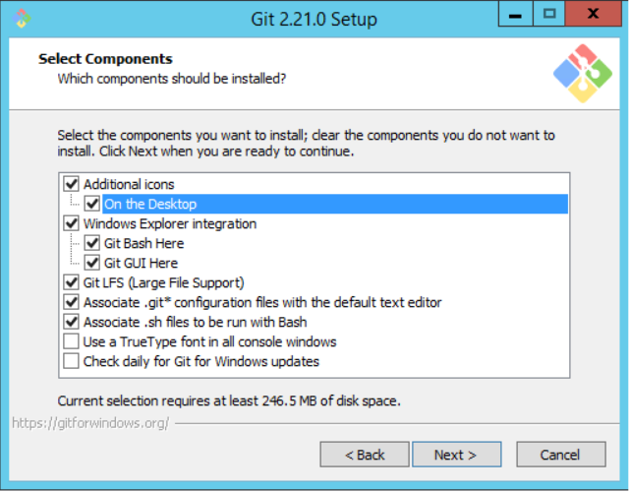
Git install

Slide 3
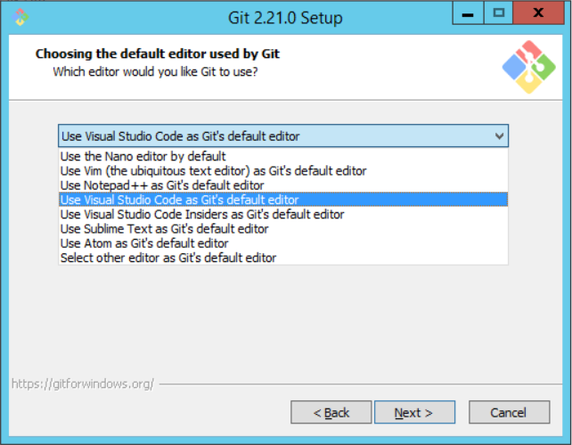
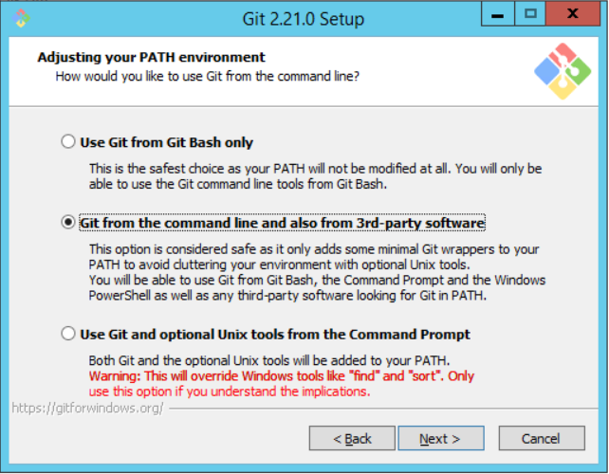

Slide 4
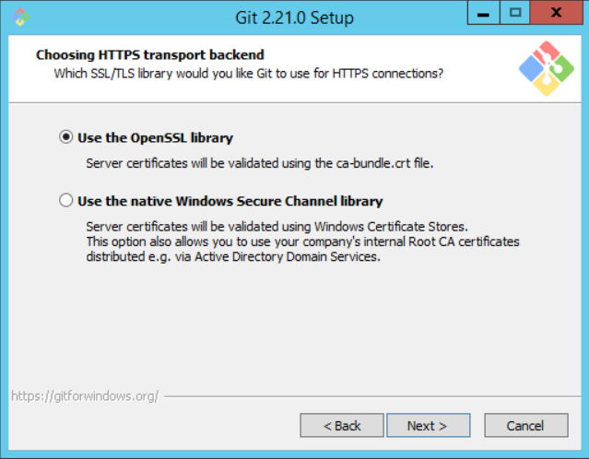
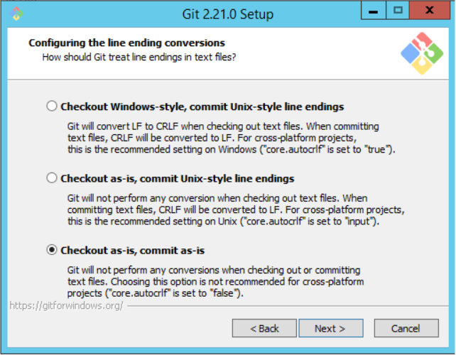

Slide 5
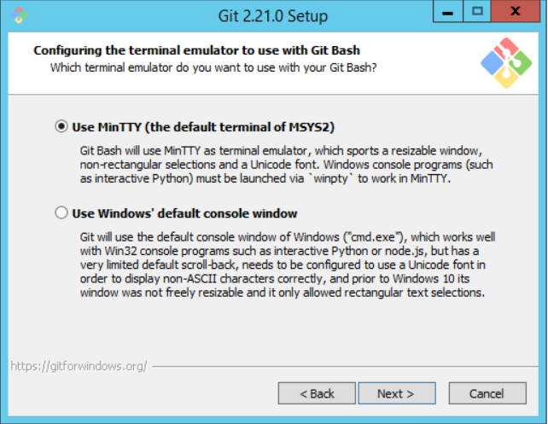
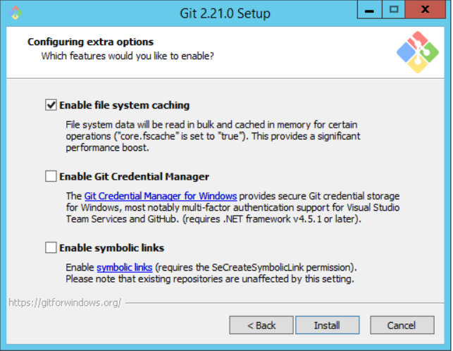

Slide 6
REsources
How the Git Credential Managers works
How does GitHub Desktop use the credentials after oauth?
Easier builds and deployments using Git over HTTPS and OAuth

